Slide 1

Dijkstra
The Explorer
Your Personalized Navigation Companion

Slide 2
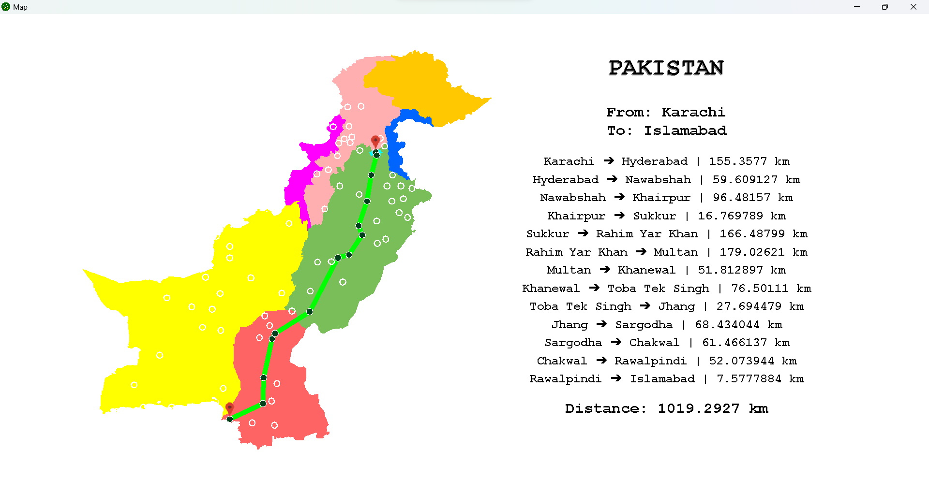
This Project is essentially about using appropriate Data Structures and Algorithms to solve daily life problems.
In our case, we make use of Graph, Heap, Linked Lists, and Arrays, along with the Dijkstra's Algorithm to create a shortest path finder between any two cities in Pakistan.
Data Structures (Class: 7294) - Fall 2023
Short Introduction of "Dijkstra the Explorer"
Group Members:
Shaikh Muhammad Sharjeel - 26932
Ikhlas Ahmed Khan - 27096
Syed Muhammad Roohallah Naqvi - 27082

Slide 3
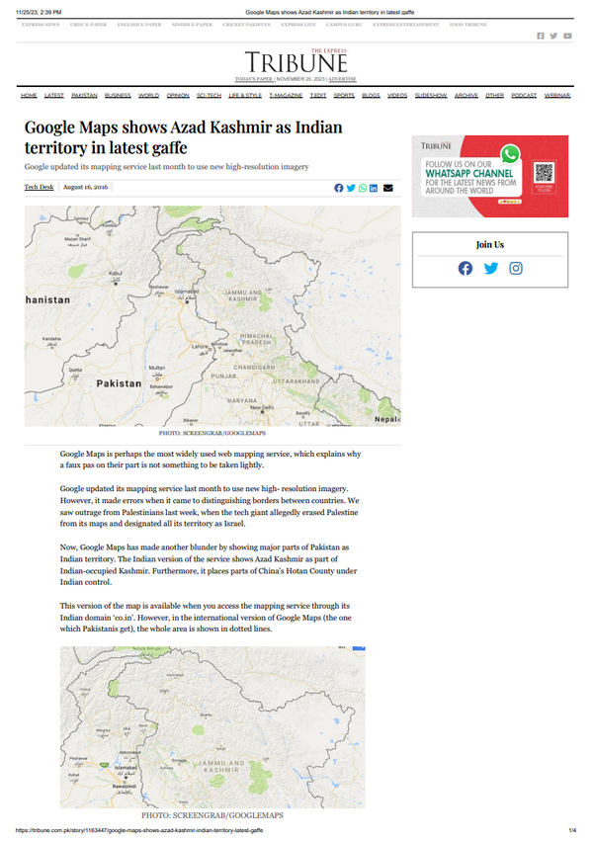

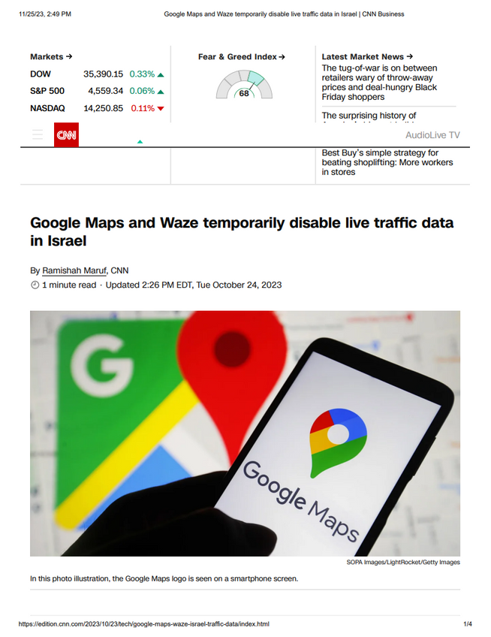
Motivation
In view of the ongoing situation around the globe, our motivation for this project is rooted in a political desire to empower marginalized communities and promote social justice.
Taking into consideration, the concerns related to the limitations of existing mapping platforms, particularly their potential to reinforce biases and exclude certain groups.
https://www.google.com/maps

Slide 4

By building your own mapping platform, we can contribute to a more open and democratic information landscape, offering several potential benefits:
Increased Transparency
Challenging Monopolies
This project can serve as a platform to showcase our knowledge of data structures - and further solidify it - while also contributing to a positive social impact.

Slide 5
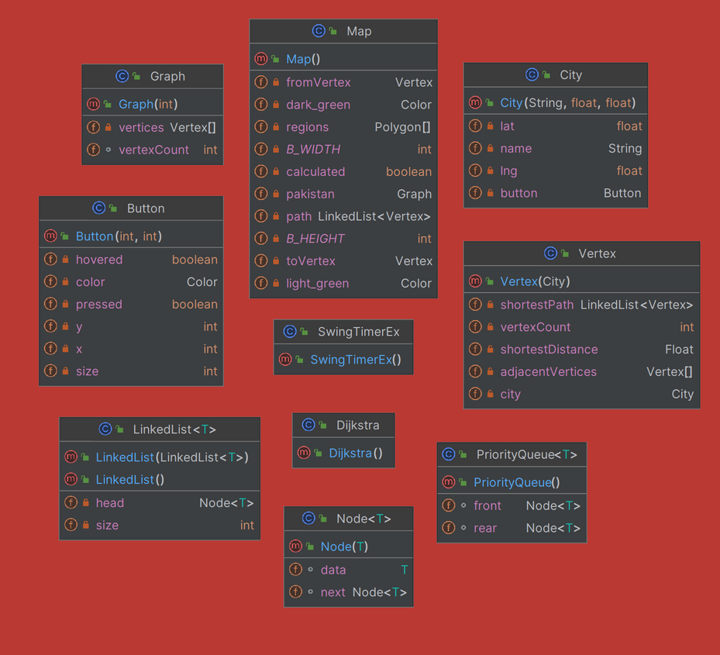
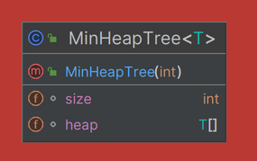
Graph
Heap
Data Structure Model
We make use of an undirected weighted graph where each edge represents a two-way road, and the weight, the distance between the two cities. Graph is the main ingredient of our project, as all the cities are stored as vertices of the graph, and their neighboring cities, as the ones adjacent to them.
We make use of a Min-Heap Tree in Dijkstra’s Algorithm to store all the unvisited vertices in a way which ensures that the vertex with the smallest tentative distance from the source node is always explored first. This prioritization leads to the efficient discovery of the shortest paths.
Linked List
Array
A Singly Linked List is used to store the shortest path of a certain vertex with respect to a source vertex (found through the implementation of Dijkstra’s Algorithm).
The use of Non-Dynamic Arrays is integral as it provides constant time random access, which is the most desired trait in a mapping platform like this implemented on GUI.

Slide 6
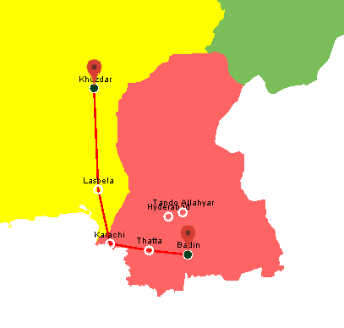
Solution
Method
We will dry run through a sample data (as shown on the left), explaining how it is stored, and the functionality it provides.
Reasoning
Along with that, we will justify the use of the data structures that we have implemented.

Slide 7



Hyderabad | Badin | Lasbela | Thatta
Graph
Karachi
Hyderabad
Badin
Thatta
Lasbela
Tando Allah Yar
Khuzdar
Karachi | Tando Allah Yar
Method
Karachi
Each city is stored as a vertex in the Graph, in the form of an array.
The neighboring cities are stored as adjacent vertices also in the form of an array (instead of a linked list).
This provides a constant time random access and requires minimum memory.
Karachi
Karachi | Khuzdar
Hyderabad
Lasbela

Slide 8
Hyderabad | Badin | Lasbela | Thatta
Graph
Karachi
Hyderabad
Badin
Thatta
Lasbela
Tando Allah Yar
Khuzdar
Karachi | Tando Allah Yar
Reasoning
Karachi
Graphs are effective for representing relationships between entities
Vertices in a graph can represent entities, and edges represent distances between these vertices.
This makes it the most suitable data structure for modeling our mapping platform.
Karachi
Karachi | Khuzdar
Hyderabad
Lasbela

Slide 9
Hyderabad | Badin | Lasbela | Thatta
Graph
Karachi
Hyderabad
Badin
Thatta
Lasbela
Tando Allah Yar
Khuzdar
Karachi | Tando Allah Yar
Combination
Karachi
A combination of Graph and array data structures is used throughout.
Using a linked list otherwise, for adjacent vertices, would give us a higher time complexity for traversal.
It is a highly repetitive task in Dijkstra’s Algorithm, which must be taken into consideration.
Karachi
Karachi | Khuzdar
Hyderabad
Lasbela

Slide 10
Linked List
Karachi to Khuzdar
Thatta to Lasbela
Method
Karachi
Thatta
The path from the source vertex to the destination vertex is stored as a Singly Linked List with a head and tail pointer. This provides efficient insertion as the shortest path is only appended from its end (tail), which provides constant time insertion.
Lasbela
Karachi
Khuzdar
Lasbela

Slide 11
Linked List
Karachi to Khuzdar
Thatta to Lasbela
Reasoning
Karachi
Thatta
Since the number of cities that constitute the path is decided at run-time, we can not implement an non-dynamic array. In case of dynamic array, space will be wasted if the initial size is set too large, and time will be wasted if set too low (because of array copying). This leaves Linked list to be the ideal choice for storing the shortest path of a vertex, w.r.t. a source vertex.
Lasbela
Karachi
Khuzdar
Lasbela

Slide 12
Min Heap Tree
Unsettled Vertices
Method
Min
Karachi
The unsettled vertices are stored in a Min Binary Heap Tree, in the implementation of Dijkstra’s Algorithm.
This provides us with retrieval in O(logV), since the value at the top of the tree is the min value, and it costs O(logV) to sift down.
Lasbela
Thatta
Khuzdar
Hyderabad
Tando Allahyar
Badin

Slide 13
Min Heap Tree
Unsettled Vertices
Reasoning
Min
Karachi
We can’t compromise on the accuracy.
A Min-Heap Tree ensures that the node with the smallest tentative distance from the source node is always explored first.
This prioritization leads to the efficient discovery of shortest paths.
Hence, it guarantees the shortest path.
Lasbela
Thatta
Khuzdar
Hyderabad
Tando Allahyar
Badin

Slide 14
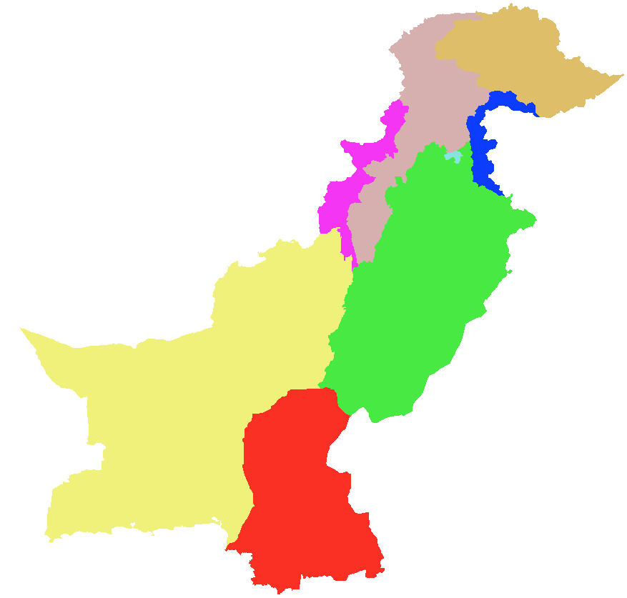
Polygon[] regions = new Polygon[8];
Array
0
1
2
3
...
Sindh | Balochistan | KPK | Punjab
Method
We also make use of arrays outside the Graph, to store the GUI data and construct the provinces of Pakistan. Storing it in the form of an array allows us a constant time retrieval for drawing.

Slide 15
Polygon[] regions = new Polygon[8];
Array
0
1
2
3
...
Sindh | Balochistan | KPK | Punjab
Reasoning
Since the number of provinces are known, it is the most memory efficient to use an array in this case. Also, each element must be constantly accessed for redrawing on the GUI, which makes array to be the perfect contender as it provides a constant time random access to its elements based on their index.

Slide 16
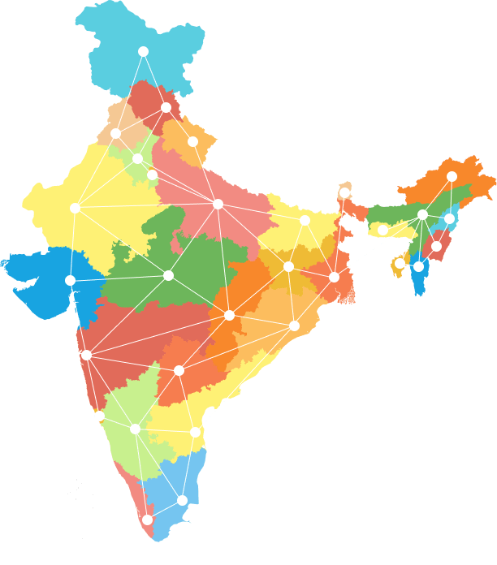


Dijkstra’s Algorithm
What?
Dijkstra's algorithm is a graph search algorithm that solves the single-source shortest path problem for a graph with non-negative edge path costs, producing a shortest path tree. This means it finds the shortest path from a single source node to all other nodes in the graph.

Slide 17
Dijkstra’s Algorithm
How?
Dijkstra's algorithm works by maintaining a set of nodes that have been visited and a set of nodes that have not been visited.
The algorithm starts by adding the source node to the visited set and setting its distance to 0. Then, the algorithm repeatedly removes the node from the unvisited set with the smallest distance and adds it to the visited set. For each neighbor of the removed node, the algorithm calculates the tentative distance to the neighbor and updates the neighbor's distance if the tentative distance is smaller than the current distance.
The algorithm continues until all nodes have been visited. At this point, the distance of each node from the source node is the shortest path from the source node to that node.

Slide 18
Dijkstra’s Algorithm
Why?
The best graph search algorithm to find the shortest path between two nodes in a graph depends on the specific characteristics of the graph and the desired trade-offs between accuracy and efficiency. Dijkstra’s algorithm proves to be the ideal pick in contrast to other prominent algorithms like A*, due to the following reasons:
Dijkstra’s Algorithm guarantees the shortest path which is crucial in a mapping platform.
Since, we have data for a limited number of cities, so Dijkstra’s Algorithm is preferred for relatively smaller graphs.

Slide 19
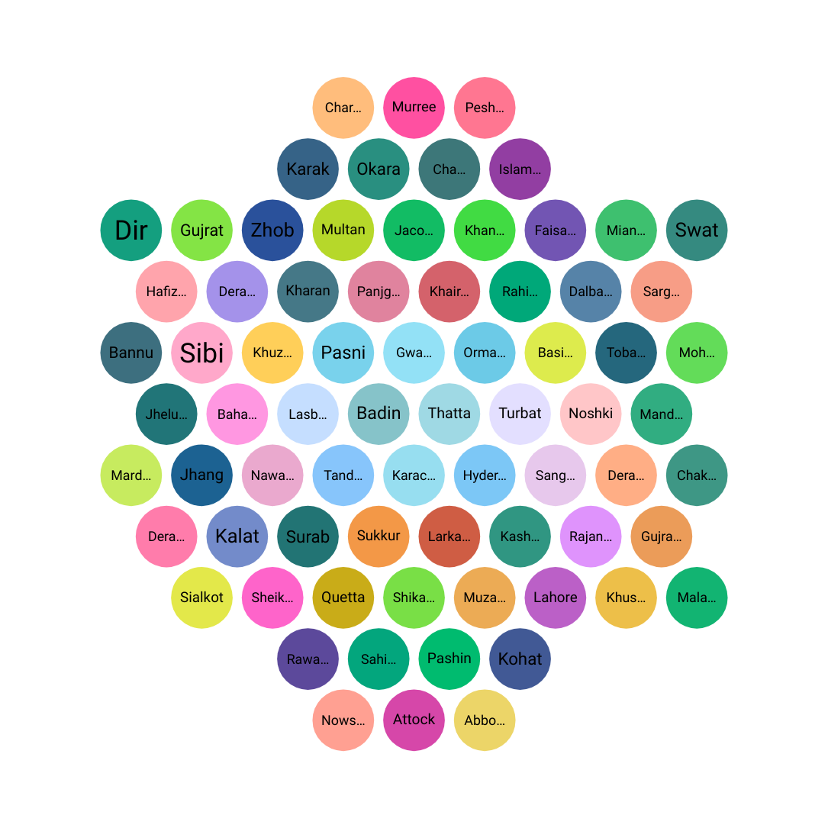

Data
Collection
We gathered data for 73 cities in Pakistan: name, latitude, longitude, and their neighboring cities connected by road.
Storing
In order to store data, we made use of the most suitable data structures, taking into consideration both, the space and time complexity, as discussed earlier.
Retrieval
We bear in mind the efficiency of data retrieval, as it is key for a mapping platform that is implemented on a GUI.

Slide 20

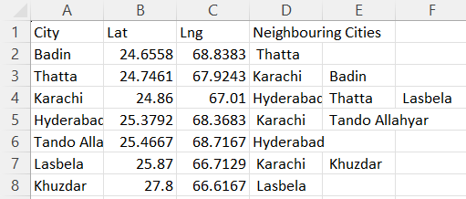
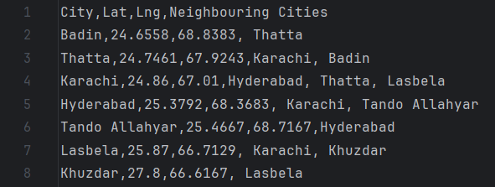
Sample Data
Comma-separated Values (sample_data.csv)
This is a sample data of 7 cities from the 73 cities in Pakistan: name, latitude, longitude, and their neighboring cities connected by road, provided in a .csv file.

Slide 21
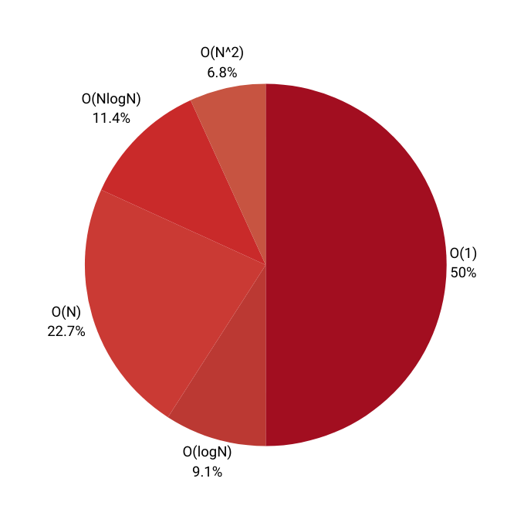
Complexity Analysis
Big O Analysis of each function implemented in the project.
This represents the distribution of time complexities (average cases) in our Project - excluding the constructors, and getter/setter methods.
Note:
V and E represents the total number of vertices and edges in the graph respectively, and both are taken as N for uniformity in this pie chart.
Class-by-Class...

Slide 22
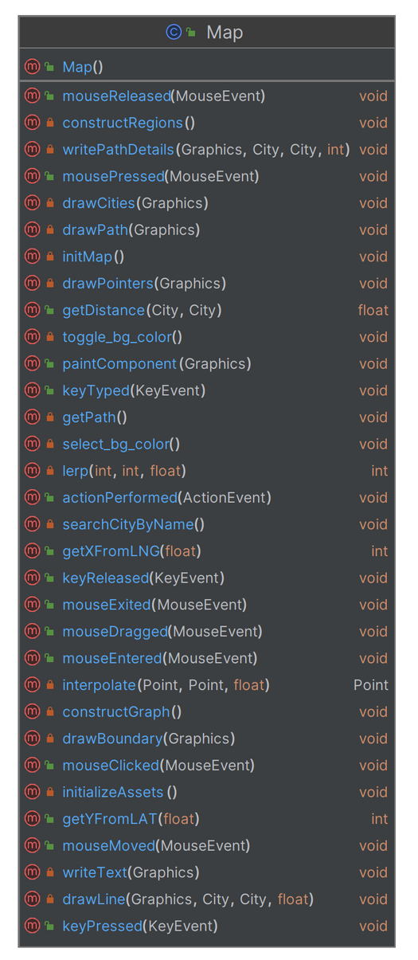
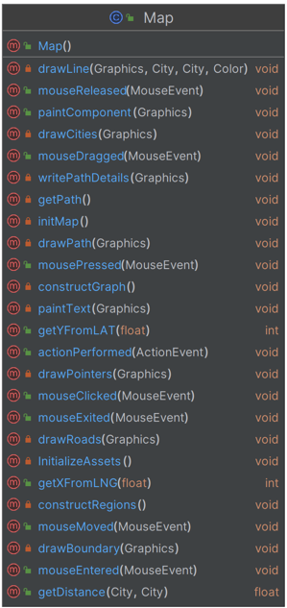
Map
Method | Big Oh
drawLine | O(1)
mouseReleased | O(1)
paintComponent | O(V)
drawCities | O(V)
reset | O(N)
writePathDetails | O(1)
mousePressed | O(V)
keyPressed | O(E*logV)

Slide 23
Method | Big Oh
constructRegions | O(N)
mouseMoved | O(V)
drawBoundary | O(N)
searchCity | O(logV)
initMap | O(E*V)
inititializeAssets | O(E*V)
interpolate | O(1)
lerp | O(1)
getPath | O(E*logV)
drawPath | O(N)
Method | Big Oh
constructGraph | O(E*V)
writeText | O(1)
getYFromLAT | O(1)
actionPerformed | O(1)
drawPointers | O(1)
toggleBgColor | O(1)
selectBgColor | O(1)
drawRoads | O(E)
getDistance | O(1)
getXFromLNG | O(1)

Slide 24
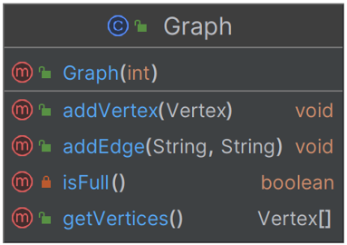
Graph
Method | Big Oh
Graph | O(1)
addVertex | O(1)
addEdge | O(V)
sort | O(V*logV)
isFull | O(1)
getVertices | O(1)

Slide 25
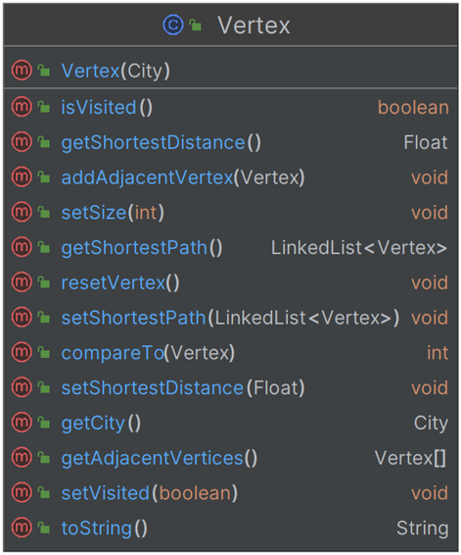
Vertex
Method | Big Oh
Vertex | O(1)
addAdjacentVertex | O(1)
resetVertex | O(1)
set/getShortestPath | O(1)
set/isVisited | O(1)
set/getShortestDistance | O(1)
getCity | O(1)
getAdjacentVertices | O(1)
compareTo | O(1)

Slide 26
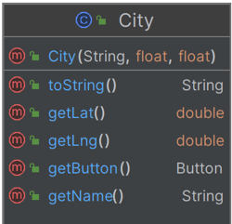
City
Method | Big Oh
City | O(1)
toString | O(1)
getLat | O(1)
getLng | O(1)
getButton | O(1)
getName | O(1)

Slide 27

Button
Method | Big Oh
Button | O(1)
isHovered | O(1)
isClicked | O(1)
draw | O(1)
displayName | O(1)
is/setPressed | O(1)
getX/Y | O(1)

Slide 28


LinkedList
Method | Big Oh
LinkedList() | O(1)
LinkedList(list) | O(N)
addLast | O(1)
isEmpty | O(1)
size | O(1)
Node | O(1)

Slide 29
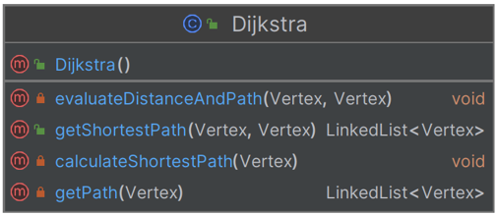
Dijkstra
Method | Big Oh
Dijkstra | O(1)
evalDisAndPath | O(1)
getShortestPath | O(E*logV)
calculateShortestPath | O(E*logV)
getPath | O(1)

Slide 30
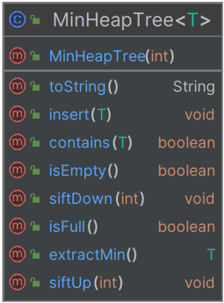
MinHeapTree
Method | Big Oh
MinHeapTree | O(1)
toString | O(N)
insert | O(logN)
isEmpty/Full | O(1)
siftUp/Down | O(logN)
extractMin | O(logN)

Slide 31

https://youtu.be/5WYAc3vgzrU

Slide 32
1 | https://www.freecodecamp.org/news/dijkstras-shortest-path-algorithm-visual-introduction/ (Dijkstra's Algorithm Understanding)
2 | https://www.baeldung.com/java-dijkstra (Dijkstra's Algorithm in Java)
3 | https://simplemaps.com/data/world-cities (for Coordinates of Cities)
4 | https://data.humdata.org/dataset/a64d1ff2-7158-48c7-887d-6af69ce21906 (for Neighboring Cities)
5 | https://cartographyvectors.com/map/998-pakistan-detailed-boundary (Pakistan Detailed Boundary with Provinces)
6 | https://www.thoughtco.com/degree-of-latitude-and-longitude-distance-4070616 (The Distance Between Degrees of Latitude and Longitude)
7 | https://www.theguardian.com/commentisfree/2023/sep/30/google-antitrust-us-department-of-justice-court-case-monopoly
8 | https://www.canva.com (Used for Presentation).
Reference Page
We ensured that the data used for this project was accurate, and mutually verified it from some trusted sources like those listed on the right.

Slide 33
Thank
You

